Slide 1
Clustering: Kmeans

Slide 2
Clustering:
Unsupervised learning, only input data, no idea about the target variables
Clustering: task of partioning the datapoints into groups, called clusters
Clusters will have datapoints which are very similar
Clustering algorithm assigns each new datapoint to the matching clusters
Applications in many fields like biology, pattern recognition, social sciences, information retrieval etc.
Can be used for:
Summarization
Find clusters first from the dataset, apply algorithm only on the cluster centers or
prototypes
Time and space complexity reduced
Compression of data set
Find prototypes, index the prototypes
Objects similar to prototypes compressed

Slide 3
Finding nearest neighbors
Requires calculating pairwise distance between data objects
Find clusters
Identify the prototypes or cluster centers
If the prototypes far apart then the corresponding data objects in both the clusters
cannot be nearest neighbors

Slide 4
Cluster Analysis
Group data objects based on the information found in the data
Similar objects come closer to form a group or cluster
Greater the similarity within a group more distinct the clusters formed

Slide 5
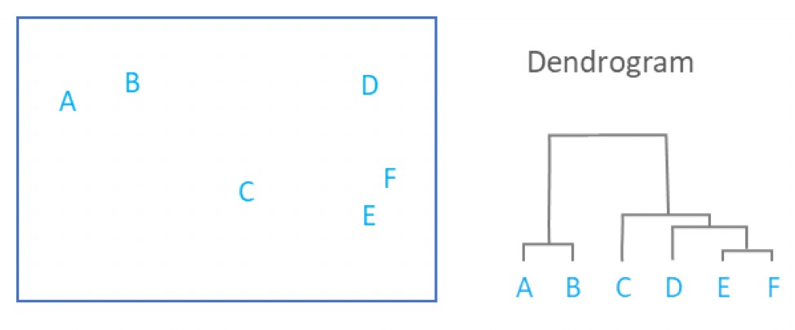
Types of clustering
1)Hierarchical vs Partitonal
Hierarchical(nested)
Subclusters permitted
Overlapping clusters
Forms a tree structure
Each node in the tree is a union of its children
Root node contains all the objects

Slide 6
Partitional (unnested)
Division of data objects into non overlapping groups

Slide 7
Quality of clusters
Jaccard Index = TP/(TP+FP+FN+TN)
Rand index =(TP+TN)/(TP+FP+FN)
Fmeausure = (2*PR)/P+R P= Precision R = Recall
Actual(+) (-)
Pred(+)
(-)
TP | FP
FN | TN

Slide 8
K means
Partitional clustering
K or the no. of clusters is given, a set of objects X is given to us
X={X₁,X₂,X₃…X_{n}}
Output cluster S = {S₁, S₂,S₃..S_{k}}
Each S_{i} has a cluster center mu_{i}
Randomly choose mean
Every data point analyzed to see to which random mean the points are closer to (Euclidean distance or the sum of squares calculated)
Mean now updated by the new points added
Based on the new cluster center we assign the data points again
Continues till convergence

Slide 9
Stopping or convergence
No re assignments of data points to different clusters (no change in mean)
Very little decrease in the distance
The convergence point may not be the global minimum
Time complexity of the algorithm is O(tknm)
t= no. of iterations
K= no. of clusters
N= no of features or size of the feature vector
M= no of data objects
Time complexity is directionally proportional to the no. of data objects
Advantages:
Robust
Easy to understand
Fast
Relatively efficient
Best results when data set is well separated

Slide 10
Disadvantages
Value of k must be given
Very difficult to visualize k if the dimensions are high
Hard assignment of data points
Applicable only when mean can be defined
Converges to a local minimum

Slide 11
k-Means: Numerical Example
Consider the following data set consisting of the scores of two variables on each of seven individuals:
Group the dataset into 2 clusters using Kmeans algorithm.
First step is to find random means.
Here instead of randomly selecting means let us find the farthest points using the Euclidean distance.
As a first step in finding a sensible initial partition, let the A & B values of the two individuals furthest apart (using the Euclidean distance measure), define the initial cluster means, giving:
Subject | A | B
1 | 1.0 | 1.0
2 | 1.5 | 2.0
3 | 3.0 | 4.0
4 | 5.0 | 7.0
5 | 3.5 | 5.0
6 | 4.5 | 5.0
7 | 3.5 | 4.5

Slide 12
Dist(1,7) | Sqrt[(1-3.5)^2+(1-4.5)^2]=4.3
Dist(1,6) | Sqrt[(1-4.5)^2+(1-5.0)^2]=5.3
Dist(1,5) | Sqrt[(1-3.5)^2+(1-5.0)^2]=4.71
Dist(1,4) | Sqrt[(1-5.0)^2+(1-7.0)^2]=7.21
Dist(1,3) | Sqrt[(1-3.0)^2+(1-4.0)^2]=3.6
Dist(1,2) | Sqrt[(1-1.5)^2+(1-2.0)^2]=1.11
Dist(2,7) | Sqrt[(1.5-3.5)^2+(2-4.5)^2]=3.2
Dist(2,6) | Continue same way for all the points
Dist(2,5)
Dist(2,4)
Dist(2,3)
Dist(3,7)
…
…..
Find Euclidean distance as in the table below for every data point. and the points with maximum distance measure will be random means .
Find the points with maximum distance measure, and that is between subject 1 and 4 so we take the subjects 1 and 4 as the initial mean point or cluster centroid.
 | Individual | Mean Vector (centroid)
Group 1 | 1 | (1.0, 1.0)
Group 2 | 4 | (5.0, 7.0)

Slide 13
The remaining individuals are now examined in sequence and allocated to the cluster to which they are closest, in terms of Euclidean distance to the cluster mean.
The mean vector is recalculated each time a new member is added.
This leads to the following series of steps:
Initially the centroid of the first cluster was (1.0,1.0) and that of the second cluster was (5.0,7.0).
We check the closest cluster for each data point.
Subject 2 which is (1.5,2.0) is close to cluster 1 so that is added to cluster 1 and now the centroid of cluster 1 is updated to [(1.0+ 1.5)/2, (1.0+2.0)/2)] which is equal to (1.25,1.5).
Nothing is added to the second cluster so the mean or the centroid of the cluster 2 remains the same as (5.0 ,7.0).
See the high lightened row in the above table. The points are checked again with the new means.
 | Cluster 1 |  | Cluster 2
Step | Individual | Mean Vector (centroid) | Individual | Mean Vector (centroid)
1 | 1 | (1.0, 1.0) | 4 | (5.0, 7.0)
2 | 1, 2 | (1.2, 1.5) | 4 | (5.0, 7.0)
3 | 1, 2, 3 | (1.8, 2.3) | 4 | (5.0, 7.0)
4 | 1, 2, 3 | (1.8, 2.3) | 4, 5 | (4.2, 6.0)
5 | 1, 2, 3 | (1.8, 2.3) | 4, 5, 6 | (4.3, 5.7)
6 | 1, 2, 3 | (1.8, 2.3) | 4, 5, 6, 7 | (4.1, 5.4)

Slide 14
This process continues till the mean value do not change.
So, after the final iteration subjects {1,2,3} is in cluster 1 and subjects {4,5,6,7} is in cluster 2.
 | Individual | Mean Vector (centroid)
Cluster 1 | 1, 2, 3 | (1.8, 2.3)
Cluster 2 | 4, 5, 6, 7 | (4.1, 5.4)

Slide 15
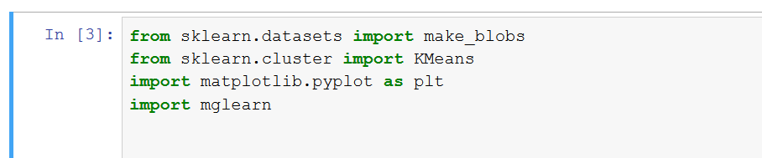
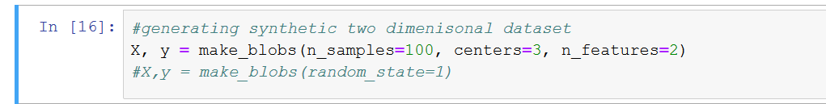
Python implementation
Import the libraries
Kmeans function in cluster module of sklearn
Generate synthetic dataset for clustering

Slide 16
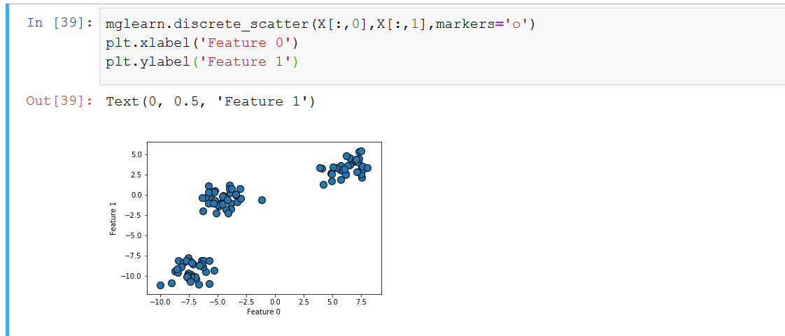
Visualize the dataset
Synthetic dataset formed with three center points, 100 samples and two features

Slide 17
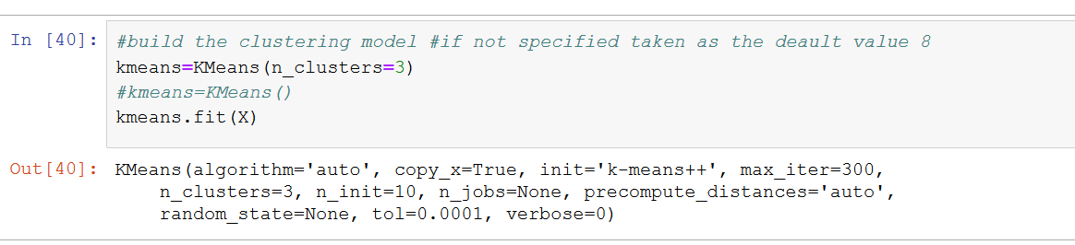
Build the kmeans clustering model with no. of clusters as 3 and fit the model to the training data X

Slide 18
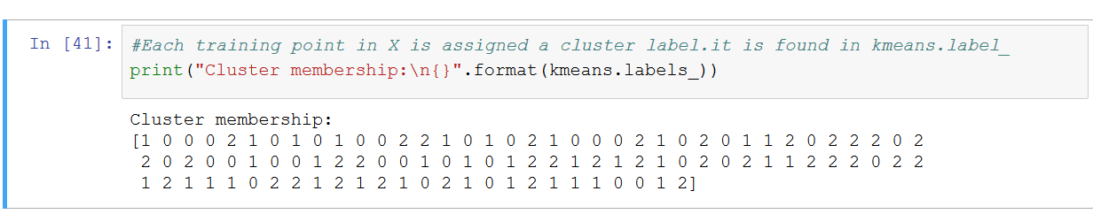
Datapoints in X assigned to 3 different clusters with the corresponding cluster labels

Slide 19
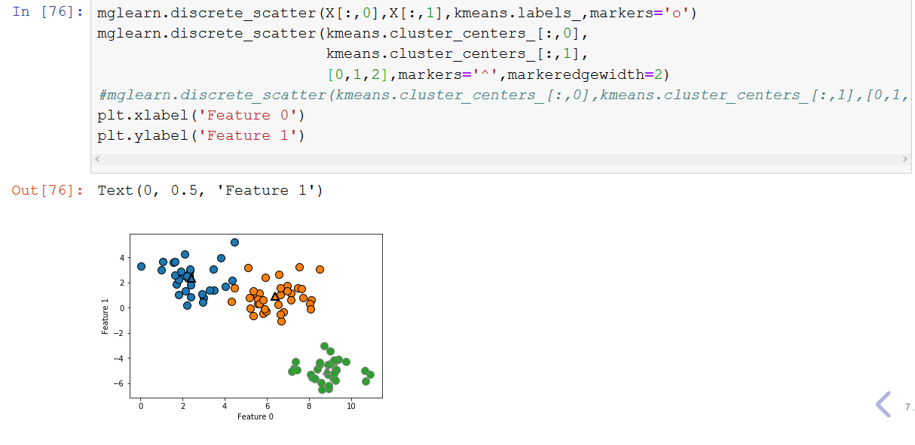
Visualize the clusters formed

Slide 20
Cluster centers are stored in the cluster_centers_attribute
Centers are indicated in the figures as triangles
Disadvantage of K means we have to specify the value of k
Different methods exist to find the optimum value of k
One such method is elbow method
run k-means clustering on the dataset for a range of values of k and for each value of k calculate the sum of squared errors (SSE).
plot a line chart of the SSE for each value of k.
If the line chart looks like an arm, then the "elbow" on the arm is the value of k that is the best

Slide 21
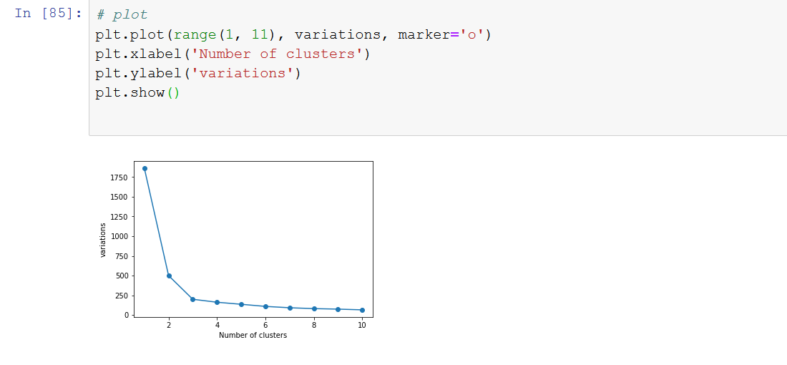
The optimum value for k= 3 according to the elbow method

